Slide 1
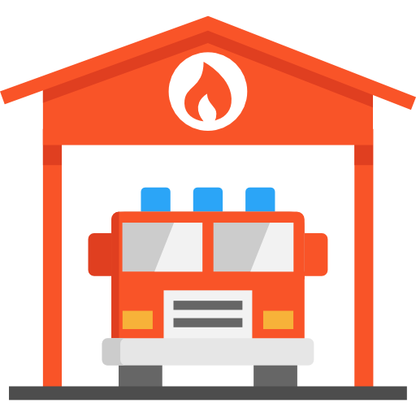
Fire Safety in Montreal Selecting the optimal location for a new fire station on the island of Montreal
Alex Cohen
Andreea Florean
Oliver Foster
Natalia Zader
December 18, 2019

Slide 2
Agenda
Problem statement
Data exploration
Feature engineering
Building the model
Results
Conclusions
Notes:
Problem statement - G&N
Data exploration - G&N
Feature engineering - Alex
Building the model - Oliver
Results - Oliver
Conclusions - Oliver

Slide 3


Risk
Readiness
QUANTIFYING RISK AND READINESS TO DETERMINE THE OPTIMAL LOCATION FOR A NEW FIRE STATION
Notes:
60% of fire data was first responder

Slide 4
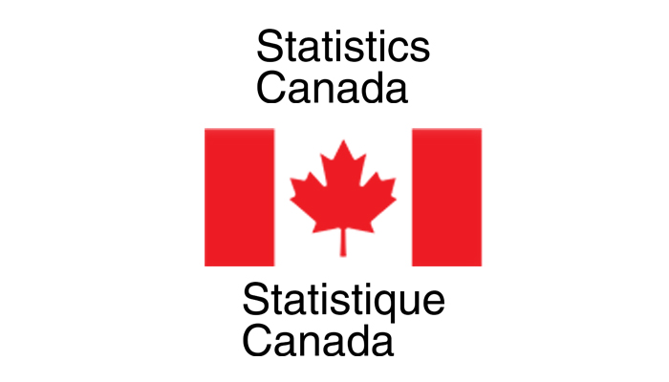








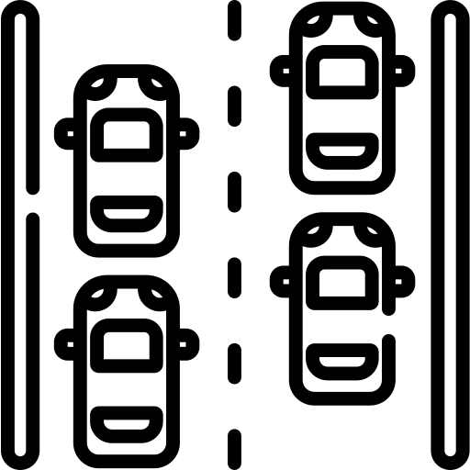

Population demographics
Building data
Income data
Geographic data
Firefighter data
Explore Data
Traffic data
Notes:
Speed of traffic

Slide 5
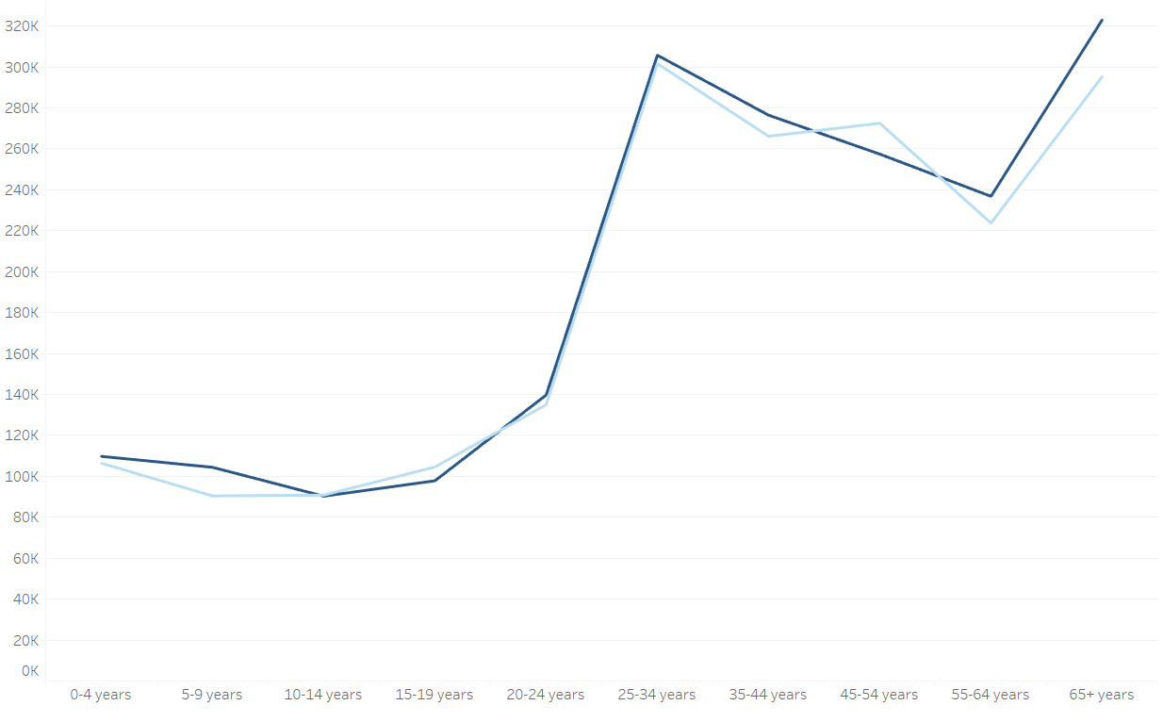
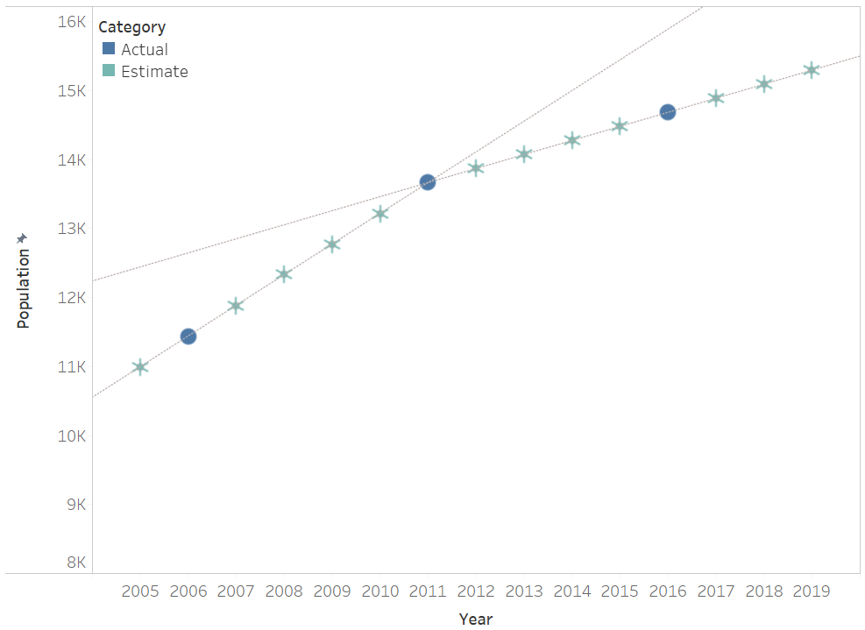
Demographics
Population 2011 vs 2016
Interpolation of census data
Explore Data

Slide 6
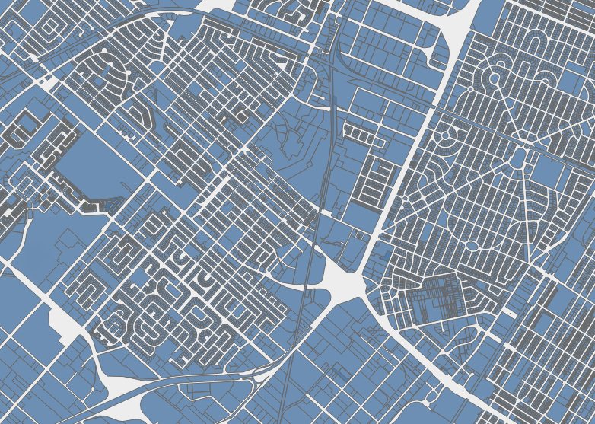
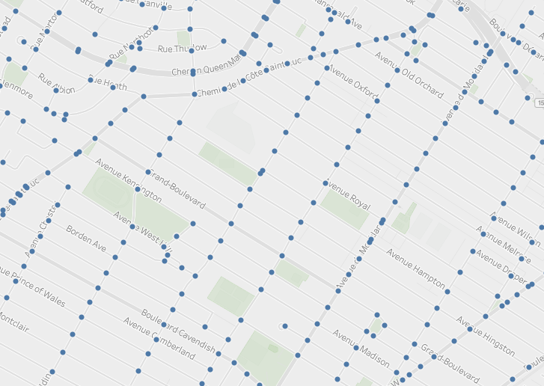
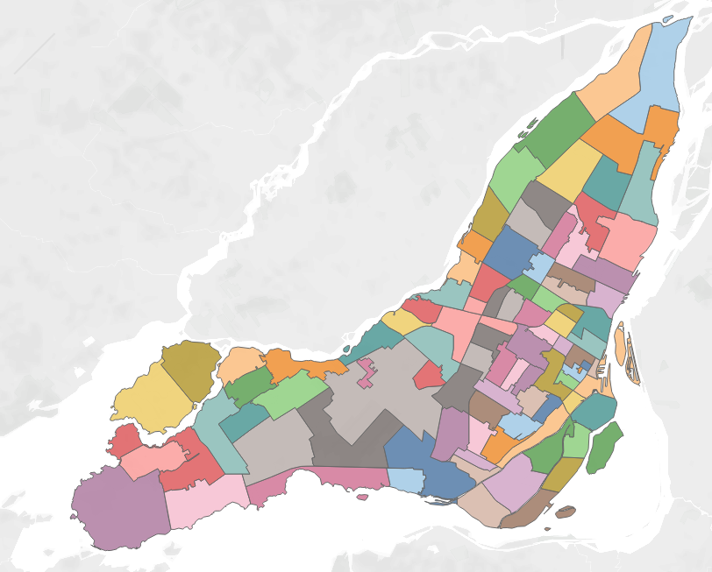
Multiple levels of granularity
Buildings
Intersections
FSA
Clean Data

Slide 7
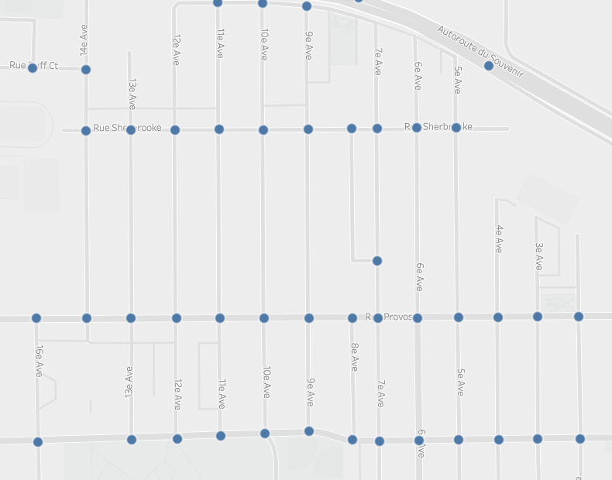
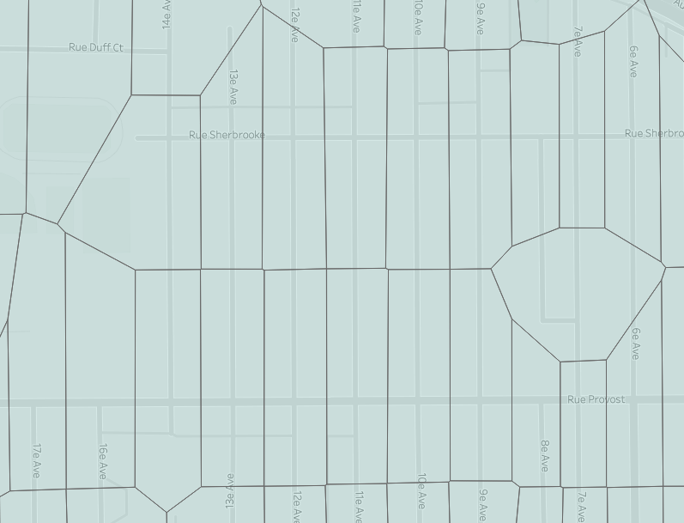
Turning intersections into polygons
Building the dataset

Slide 8
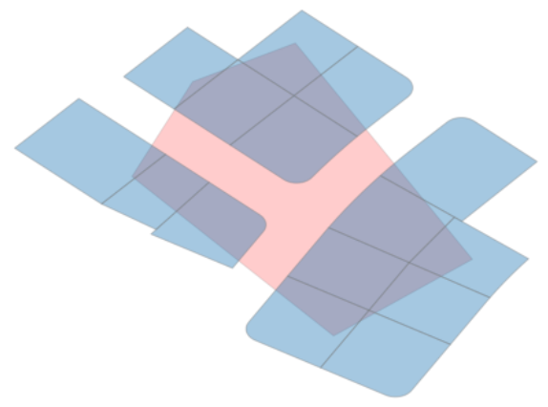
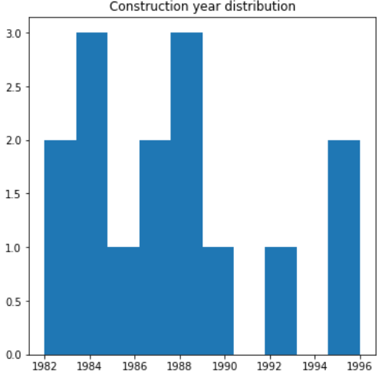
Summarizing building statistics
Feature Engineering

Slide 9
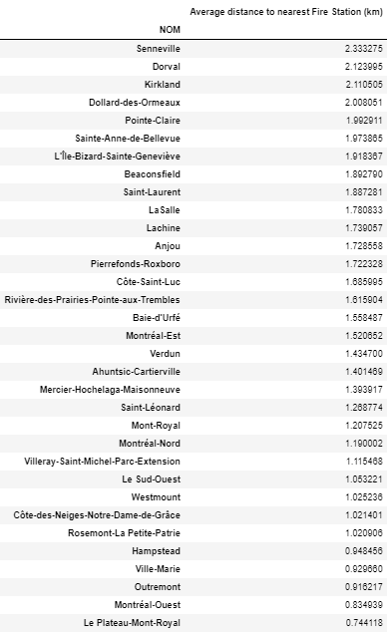
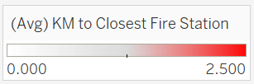
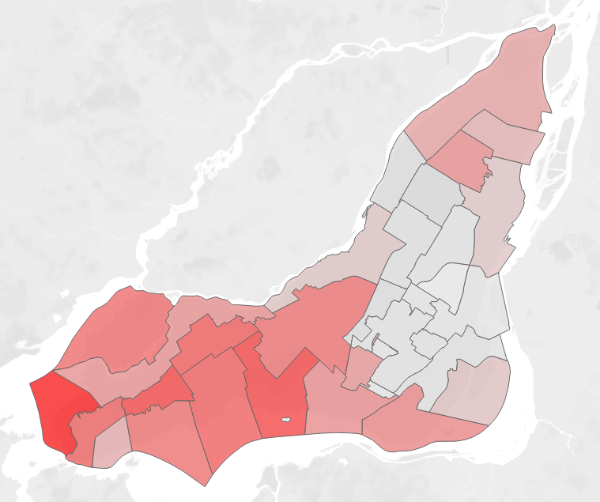
Naive Approach: Distance by Road
Calculate the distance by road from every intersection in Montreal to the nearest Fire Station
Use the distance to the nearest fire station as a proxy for the level of preparedness to handle a given fire incident

Slide 10
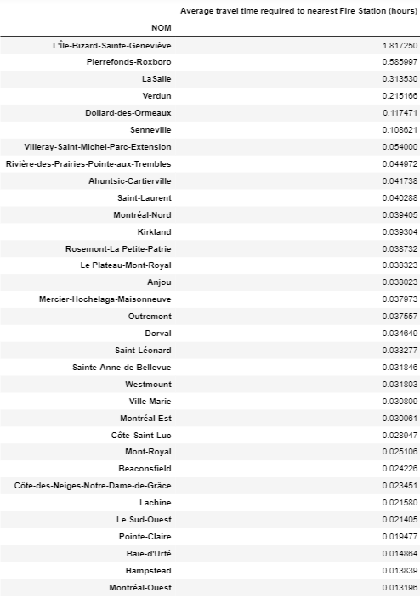
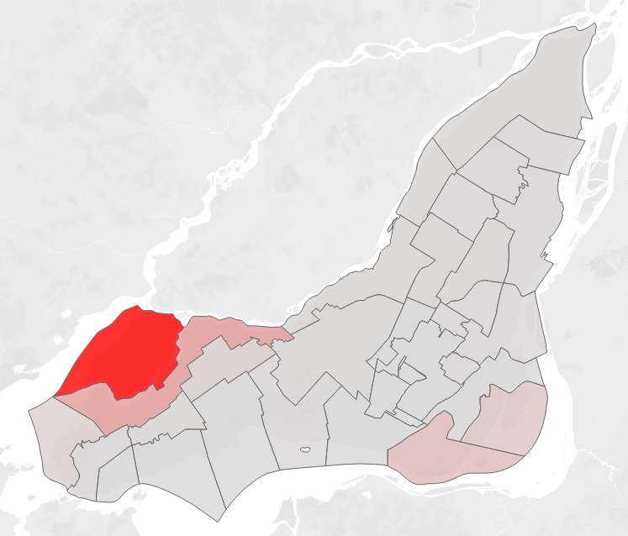
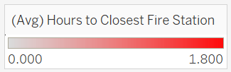
Final Approach: Time to Fire Station
Calculate the time required to travel from every intersection in Montreal to the nearest Fire Station
For this task free-flow traffic data is required: extract from TomTom

Slide 11
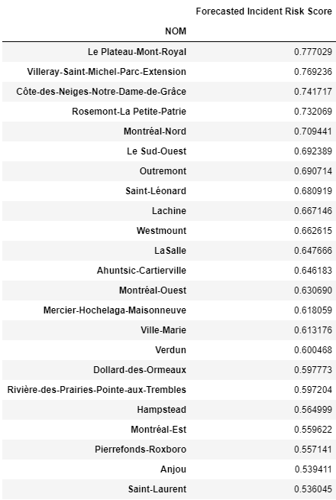
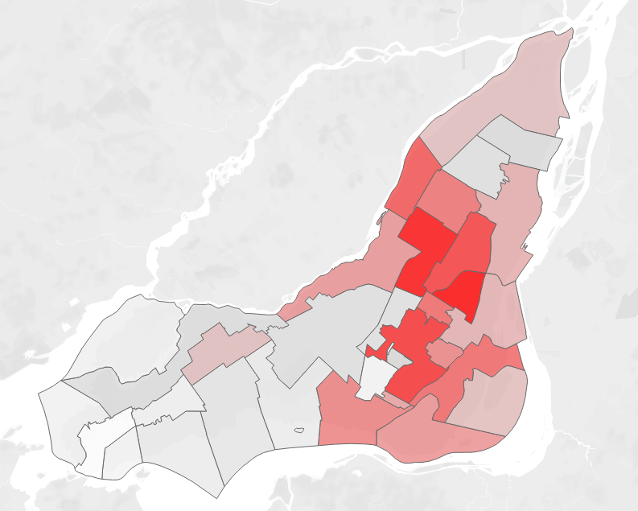
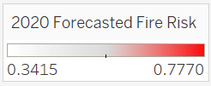
2020 Forecasted Incident Risk
Using our forecasting algorithm we have predicted the neighborhoods most likely to experience fire incidents in Montreal
Using data from 2019, we can predict what is likely to happen in 2020 with 78.78% accuracy

Slide 12
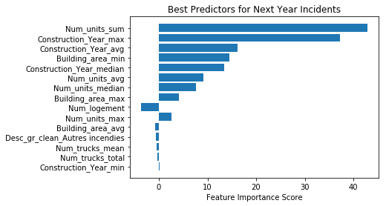
What are the best predictors of Fire Incidents?
The age and size of buildings are the optimal predictors of next-year incidents

Slide 13
Conclusion
Combination of risk and readiness show that best location for another fire station is Verdun/Lasalle
Most important features are building information
Potential next steps
Incident data by building
More granular information for demographics, $

